Slide 1
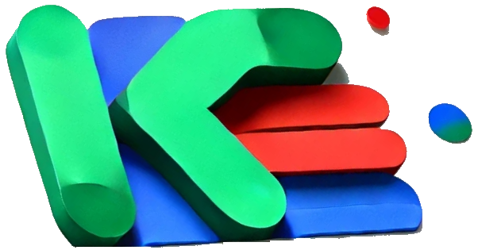
Knowledge
Knowledge
Knowledge

Slide 2
Knowledge
Intro:
TEDx DATANAUTS
May 29th, 2014
The Offline Bookmarking Gap
The Processing Workflow
Tag generation
Graph drawing
Knowledge
Knowledge

Slide 3

TEDx Datanauts

Slide 4
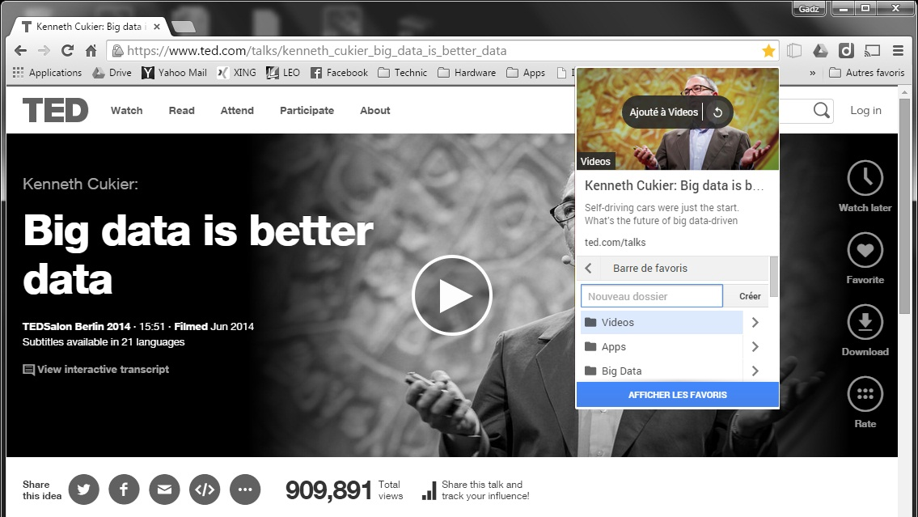

Slide 5
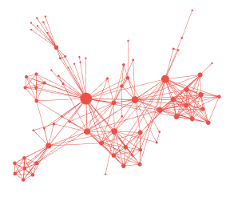
Processing Workflow
Tag generation
Graph drawing

Slide 6
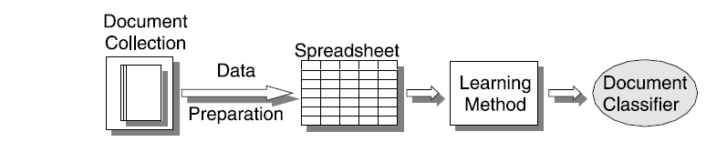
Tag generation
Tag generation
Graph drawing
New Doc
New Doc
#
Advantages:
Predictive generation of tags
Supervised classification
Link to the articles stored in the database with similar tags

Slide 7


Tag generation
Step 1
Step 2
Document Collection
Spreadsheet
Data
Preparation
Learning method
Document classifier
New Doc
Document Collection
Spreadsheet
Data
Preparation
Learning method
Document classifier
New Doc
#

Slide 8
Graph drawing
Automatic tag generation
Graph drawing
Tag generation
1
1.Knowledge Graph - Wikipedia, the free encyclopedia
Tags: google wikipedia science
T59 =
1
#1 science
#2 research
#3 wikipedia
#4 google
#5 visualisation
#tag1
1
0
1
1
0
#tag2
#tag3
#tag4
#tag5

Slide 9
Graph drawing
1 | 0 | 1 | 1 | 0
1 | 0 | 1 | 1 | 0
1 | 1 | 0 | 0 | 0
0 | 0 | 0 | 0 | 1
0 | 1 | 0 | 0 | 1
1 | 1 | 0 | 0 | 1
0 | 0 | 0 | 0 | 1
1 | 0 | 0 | 0 | 1
0 | 0 | 1 | 1 | 0
Automatic tag generation
Graph drawing
Tag generation
Z55 = T59 *T95
T59 =
1
2
3
4
5
6
7
8
9
#tag1
1 | 1 | 1 | 0 | 0 | 1 | 0 | 1 | 0
0 | 0 | 1 | 0 | 1 | 1 | 0 | 0 | 0
1 | 1 | 0 | 0 | 0 | 0 | 0 | 0 | 1
1 | 1 | 0 | 0 | 0 | 0 | 0 | 0 | 1
0 | 0 | 0 | 1 | 1 | 1 | 1 | 1 | 0
5 | 2 | 2 | 2 | 2
2 | 3 | 0 | 0 | 2
2 | 0 | 3 | 3 | 0
2 | 0 | 3 | 3 | 0
2 | 2 | 0 | 0 | 5
#tag2
#tag3
#tag4
#tag5

Slide 10
From adjacency matrix to Graph
Automatic tag generation
Graph drawing
Tag generation
0 | 0 | 1 | 1 | 1
0 | 0 | 1 | 0 | 0
1 | 1 | 0 | 1 | 1
1 | 0 | 1 | 0 | 1
1 | 0 | 1 | 1 | 0
1
5
4
3
2

Slide 11
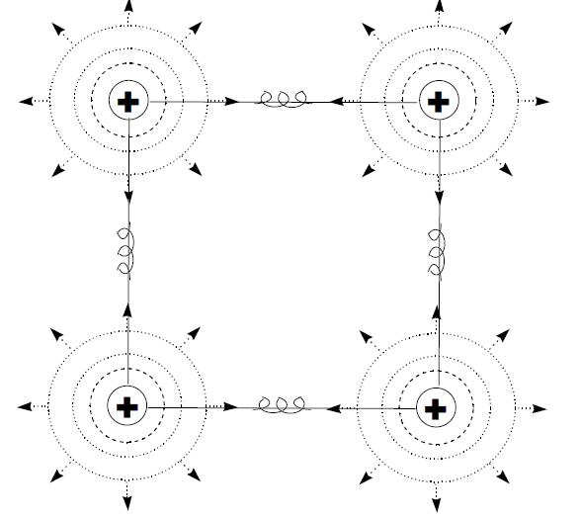
Force-directed Graph drawing
Automatic tag generation
Graph drawing
Tag generation

Slide 12
Terminology
Artificial Intelligence
Machine Learning
Deep Learning

Slide 13
Machine Learning
Unsupervised Learning
Clustering
Machine Learning
Classification
Supervised Learning
Regression

Slide 14
Deep Learning
Inputs
Outputs
Input Layer
Output Layer
Hidden Layers
Notes:
https://www.mathworks.com/discovery/deep-learning.html

Slide 15
Self-supervised next word prediction
the | quick | brown | fox | jumps | over | the | lazy | dog
the | quick | brown | fox | jumps | over | the | lazy | dog
the | quick | brown | fox | jumps | over | the | lazy | dog
the | quick | brown | fox | jumps | over | the | lazy | dog
the | quick | brown | fox | jumps | over | the | lazy | dog
the | quick | brown | fox | jumps | over | the | lazy | dog

Slide 16
Timeline of Natural Language Processing
Bag of words
Bi-directional LSTM
Attention based
Word Embeddings
Recurrent Neural Networks
Long Short-Term Memory
Transformers
Notes:
https://en.wikipedia.org/wiki/Transformer_(deep_learning_architecture)

Slide 17
Large Language Models Landscape
GPT-1
117M
GPT-2
1.5B
LLaMa
65B
GPT-3
175B
GPT-4
???
Notes:
The idea of a large language model is not new.
<click>It all started with models with millions of parameters, which back in the day were considered HUGE.
Then with time, models were getting bigger and using more training data, to the point that models now easily get to billions of parameters <click>
And of course, there is GPT-4, which is possibly even larger, but OpenAI has not revealed much about it.
There are different flavours of LLMs, some of initial models were what we call “Encoder Models”, which don’t generate text, but can be used via transfer learning for different tasks, for example text classification <click>
There are also generative models, which is what people usually think when we talk about LLMs these days.
So this presentation will be mostly about the Generative Models, but at the end of this presentation I will talk a bit about BERT.

Slide 18




Chaining
Based on a given query, chaining means triggering a pipeline, calling agents and tools
OpenAI
Search
Query
Agent
Tool
Answer

Slide 19









Develop LLM-based apps Connect to Local data
Skills
Use data.csv
How many rows?
Memory
Plot the data
Connectors
Notes:
Inspired by Microsoft Semantic Kernel https://devblogs.microsoft.com/semantic-kernel/hello-world/ https://www.linkedin.com/learning/introducing-semantic-kernel-building-ai-based-apps/introducing-semantic-kernel https://learn.microsoft.com/fr-fr/semantic-kernel/howto/schillacelaws

Slide 20
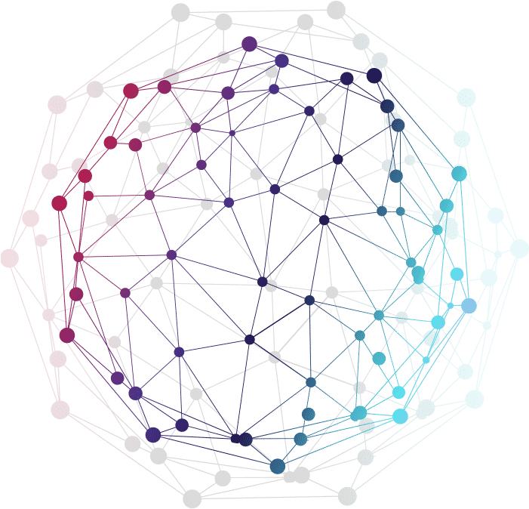
Processing Workflow
Tag generation
Graph drawing

Slide 21
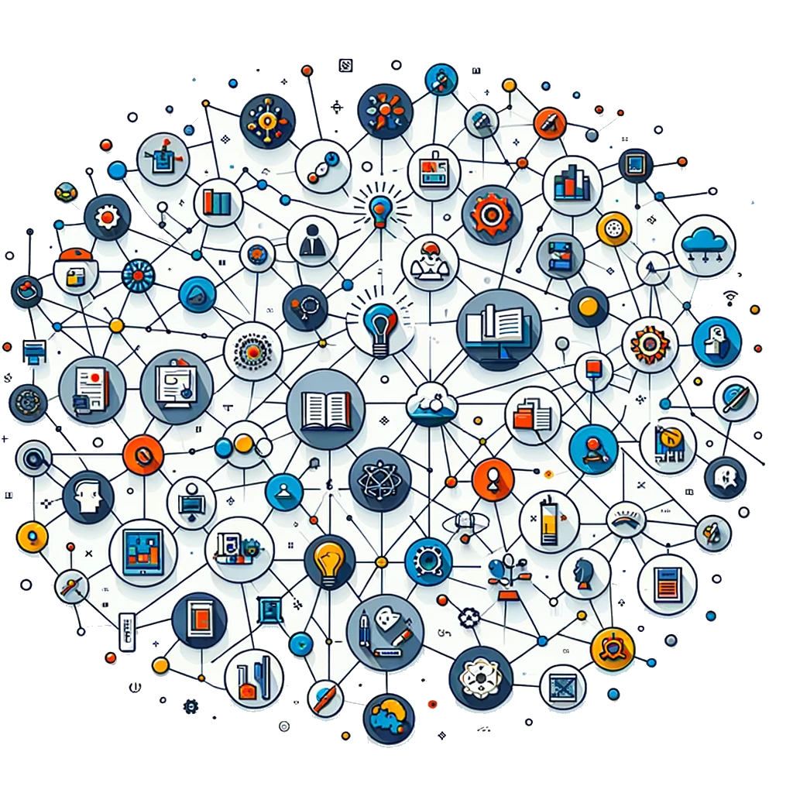
Processing Workflow
Tag generation
Graph drawing

Slide 22


Slide 24
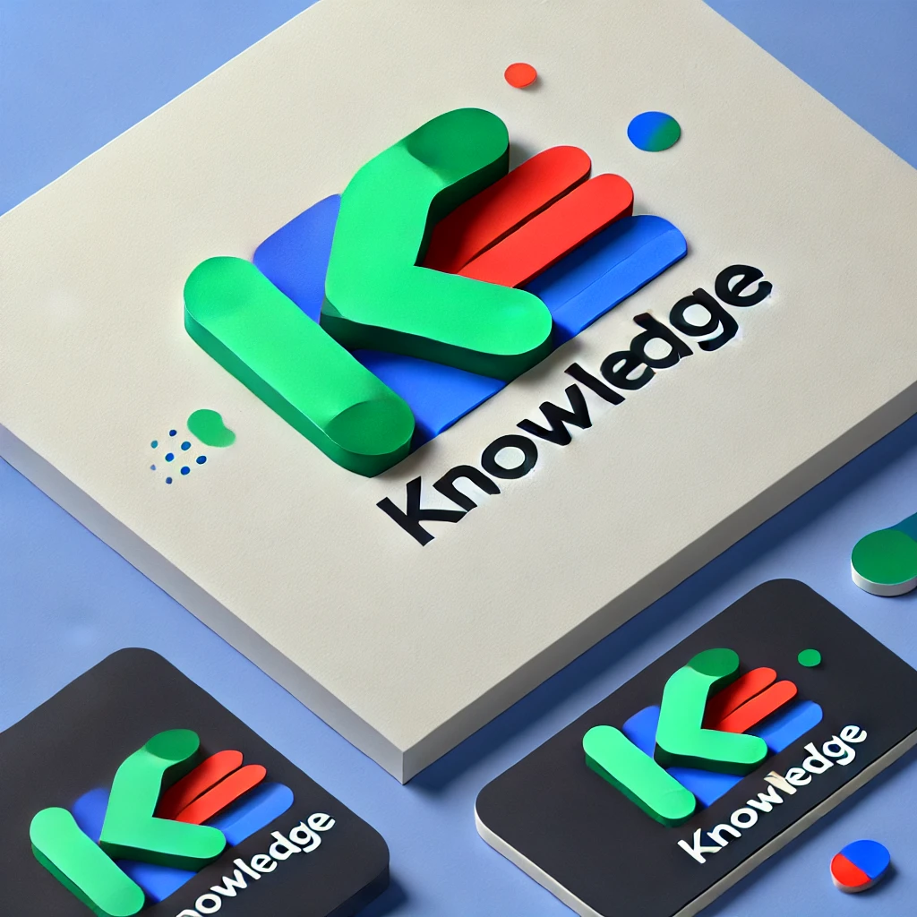

Slide 26
Knowledge
Knowledge
Knowledge

Slide 27
Knowledge
Knowledge
Knowledge

Slide 28

Knowledge
Knowledge
Knowledge

Slide 29
Knowledge
Knowledge

Slide 30

Knowledge
Knowledge

Slide 31

Knowledge
Knowledge

Slide 32
Knowledge
Knowledge

Slide 33

ChatGPT
https://openai.com/blog/chatgpt

Slide 34

ChatGPT API
https://openai.com/blog/introducing-chatgpt-and-whisper-apis

Slide 35
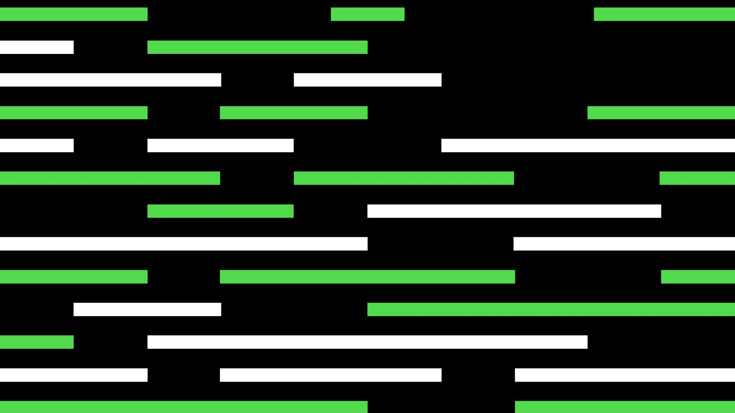
GPT-4
https://openai.com/product/gpt-4

Slide 36


Slide 37


Slide 38


Slide 39
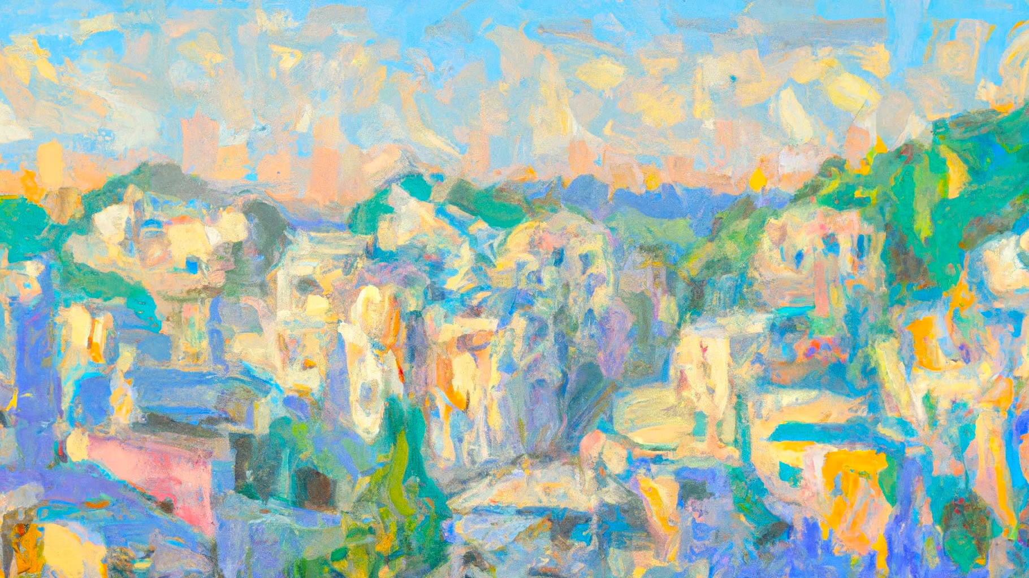
Notes:
https://openai.com/blog/planning-for-agi-and-beyond
Illustration: Justin Jay Wang × DALL·E

Slide 40
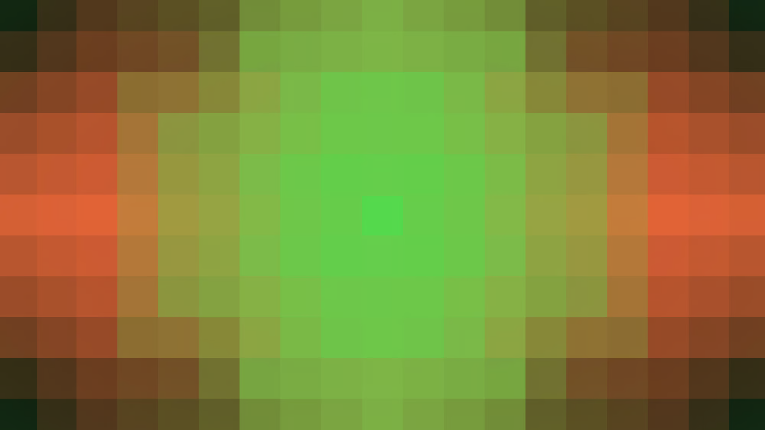
Notes:
https://openai.com/research/improving-mathematical-reasoning-with-process-supervision

Slide 41
